Slide 1




Module 16 – System Example
Training Modules for Applying the Mitigation Hierarchy:
Planning Policy and Projects for No Net Loss or a Net Gain of Biodiversity
Module 16
Example of a state-level system

Slide 2
Module on Example of a National or State System
Victoria, Australia – Abstract
Example: The system for mitigation in Victoria, Australia
This Module aims to illustrate an earlier Module on planning to achieve Biodiversity Net Gain (or No Net Loss or similar goal) with the example of the State of Victoria in Australia.

Slide 3
Module on the example of Victoria, Australia
Contents | Slides
Victoria and its biodiversity, including ecological vegetation classes | 4-10
Biodiversity offsetting in Victoria: the Regulation, habitat condition scores, like for like and estimating loss and gain | 11-25
Implementation of offsets – the offset market – credits, standards, registry | 26-37
The Western Grassland reserve as an example of aggregated offsets | 38-39
Evolution of offsetting in Victoria | 40
Concluding remarks | 41

Slide 4
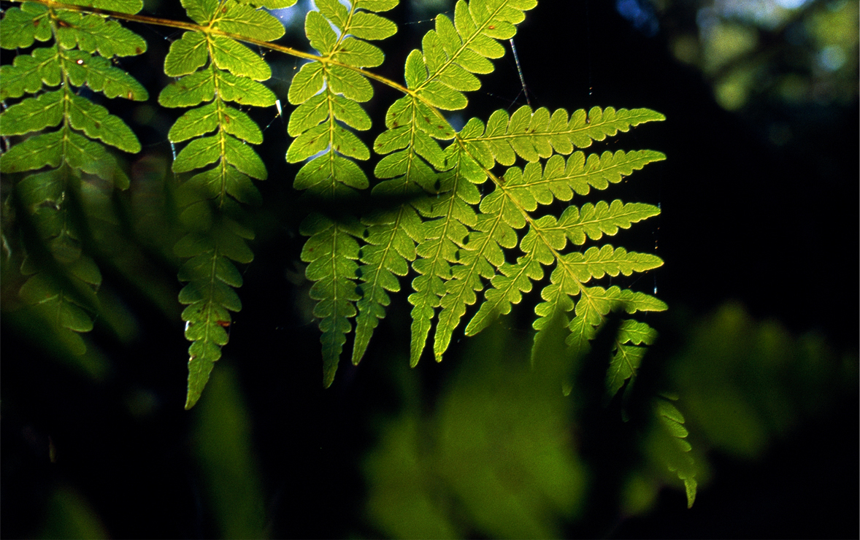
Victoria
Biodiversity offsetting in Victoria: an example
With thanks to Michael Crowe
Notes:
Since the arrival of European settlers Victoria has experienced substantial loss of biodiversity
Fertile areas were selected for agriculture and cleared for agriculture and other land uses
The remaining public land is often rocky and steep – while the biodiversity is generally intact, it differs from that found on the private land
Remaining biodiversity on the private land is fragmented and what remains has reduced quality
The split between the public and private land and the loss of quality on the private land both influence the operation of offsetting in Victoria

Slide 5
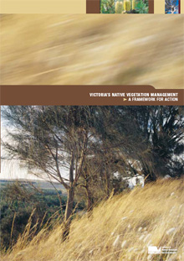

Offsetting in Victoria: outline
Victoria and its biodiversity
Biodiversity offsetting in Victoria
Implementation of offsets – the offset market
Evolution of offsetting in Victoria
Notes:
This module is about biodiversity offsetting in the state of Victoria
It covers four areas:

Slide 6

Bioregions of Victoria

Slide 7
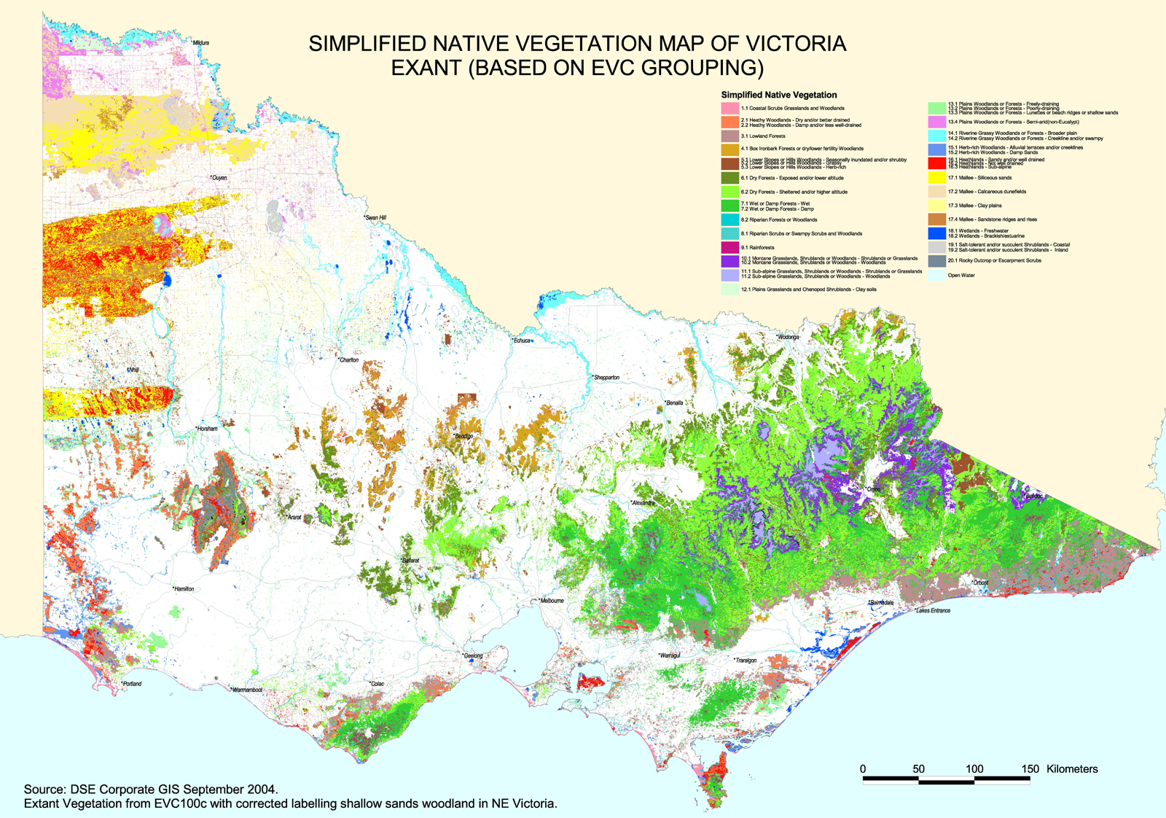
Native vegetation map of Victoria:
Ecological Vegetation Classes
Notes:
historically, clearing of native vegetation has been the major impact on biodiversity
It has a large conservation reserve system on public land with generally intact vegetation
clearing has been highly selective - two thirds of Victoria is private land of which over 90% has been cleared. As a result, the native vegetation on private land is fragmented into patches and scattered trees

Slide 8
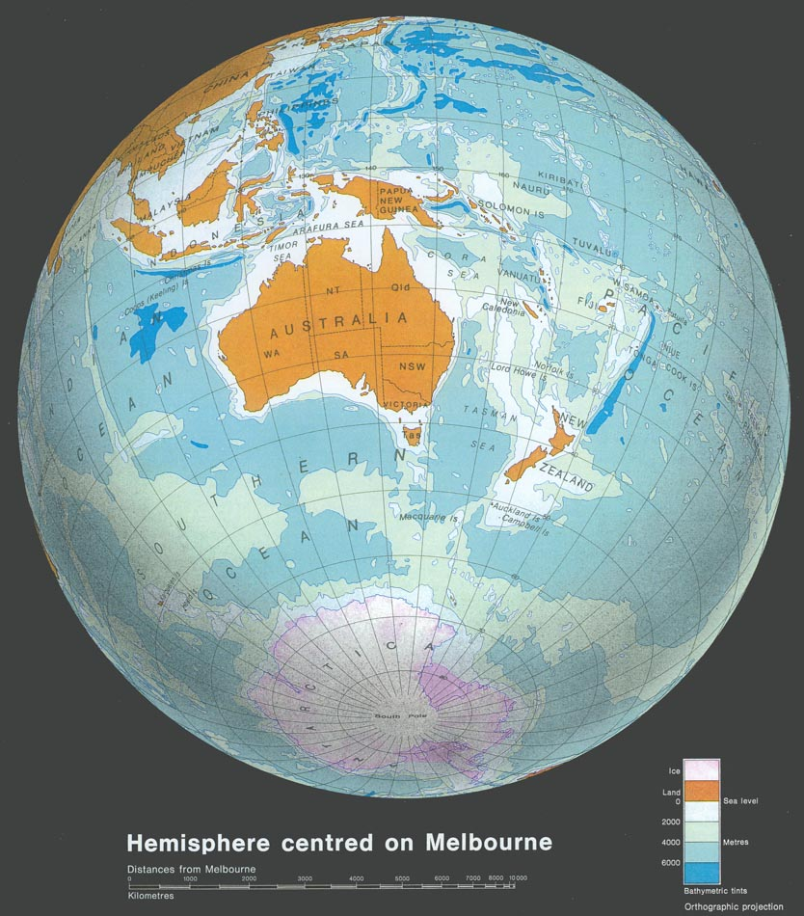
Victoria
Notes:
Since the arrival of European settlers Victoria has experienced substantial loss of biodiversity
Fertile areas were selected for agriculture and cleared for agriculture and other land uses
The remaining public land is often rocky and steep – while the biodiversity is generally intact, it differs from that found on the private land
Remaining biodiversity on the private land is fragmented and what remains has reduced quality
The split between the public and private land and the loss of quality on the private land both influence the operation of offsetting in Victoria

Slide 9
Historical biodiversity loss
Vegetation clearing has caused a major impact on biodiversity
    loss of habitat
    threatened species
Clearing was highly selective – two thirds is private land of which ~90% has been cleared
Vegetation on private land is fragmented into patches and scattered trees
Quality also degraded
Victoria 1750
Victoria 2012
Notes:
Since the arrival of European settlers Victoria has experienced substantial loss of biodiversity
Fertile areas were selected for agriculture and cleared for agriculture and other land uses
The remaining public land is often rocky and steep – while the biodiversity is generally intact, it differs from that found on the private land
Remaining biodiversity on the private land is fragmented and what remains has reduced quality
The split between the public and private land and the loss of quality on the private land both influence the operation of offsetting in Victoria

Slide 10
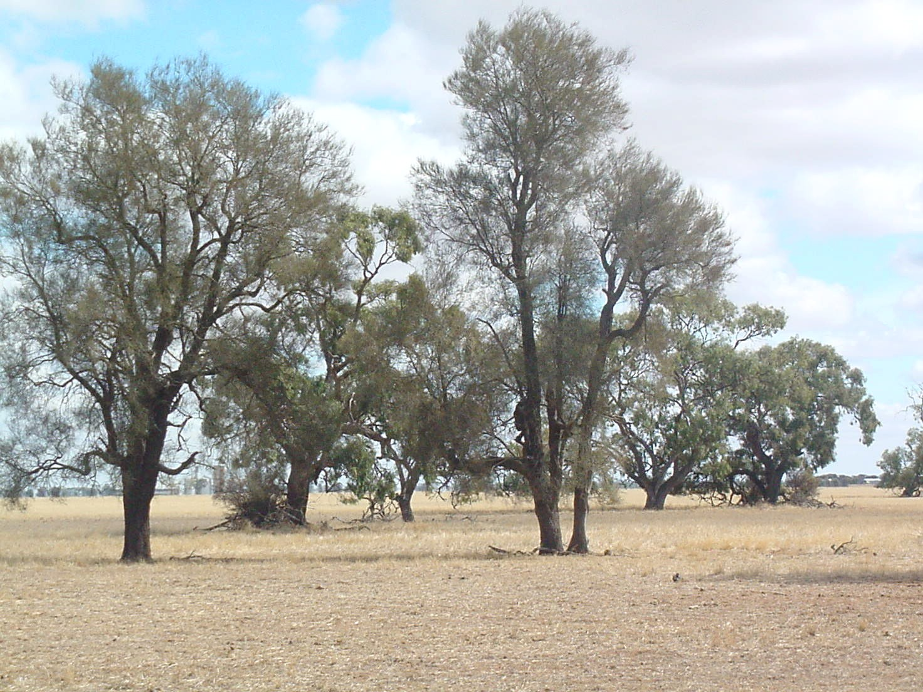
Variations of quality
Notes:
This illustrates the loss of vegetation quality
The large trees remain, but the native understory has been replaced by cropping and grazing
In the absence of protection, the trees will eventually also be lost due to the absence of recruitment of new trees
Regulations were introduced in response to this ongoing loss of biodiversity

Slide 11
The Regulation
Regulation of native vegetation clearing:
  Under the Planning and Environment Act
  A planning permit is required to clear native vegetation
  Assessment of permit applications based on the biodiversity significance of the impact
  Applications must demonstrate ‘avoid’ and ‘minimise’ steps
  The permit (if granted) requires an offset
Notes:
The regulation is based on control of the clearance of native vegetation. In this context, native vegetation is surrogate for biodiversity.
A planning permit is required to clear native vegetation.
Assessment of permit applications based on:
the biodiversity significance of the impact
land protection impacts (water quality, soil erosion,……)
Applications must demonstrate ‘avoid’ and ‘minimise’ steps.
The permit (if granted) requires an offset.

Slide 12
Regulatory approach to impacts
Exempt
Small
Medium
Large
Impacts
Exempt
Local government
EIA
Eg
fire protection
fence lines
emergency works
State government
Notes:
Some activities are exempt from the requirement to apply for a permit.
These include such activities as:
clearing for fire breaks around property;
clearing for fence lines along property boundaries; and
clearing for emergency works around power lines and the like.
In the first instance permit applications are made to local government.
Applications involving small impacts are assessed by the local government, while the remainder are referred to the State government agency for assessment.
Large projects subject to EIA are also assessed by the State agency.

Slide 13
Offset policy in Victoria
The nature and size of the offset is set by the offset policy (statutory document):
  No Net Loss
  offsets are secure and ongoing
  quality/area metric - habitat hectares
  like for like rules for losses and offsets
  graduated requirements on biodiversity significance
Notes:
The nature and size of the offset is set by Native Vegetation Management Framework policy - a statutory document. The main features of the Framework are:
offsets must meet the principle of No Net Loss
offsets are secure and ongoing
a quality/area metric is specified - called habitat hectares
like for like rules apply for losses and offsets
the requirements for offsets vary according to biodiversity importance – in the Framework this is referred to as Conservation Significance

Slide 14
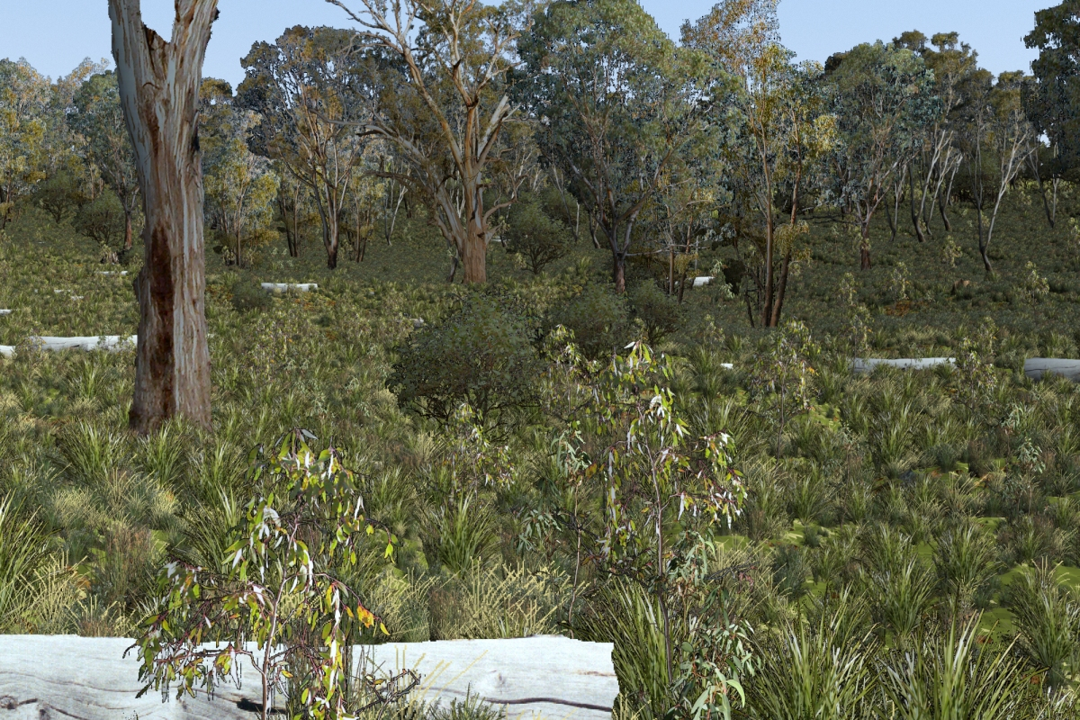
High condition site – benchmark attributes measured
size & connectivity of the patch
tree canopy cover
large old trees
understorey diversity
recruitment of young trees
logs & organic litter
Habitat condition score = 9/10
Notes:
.

Slide 15
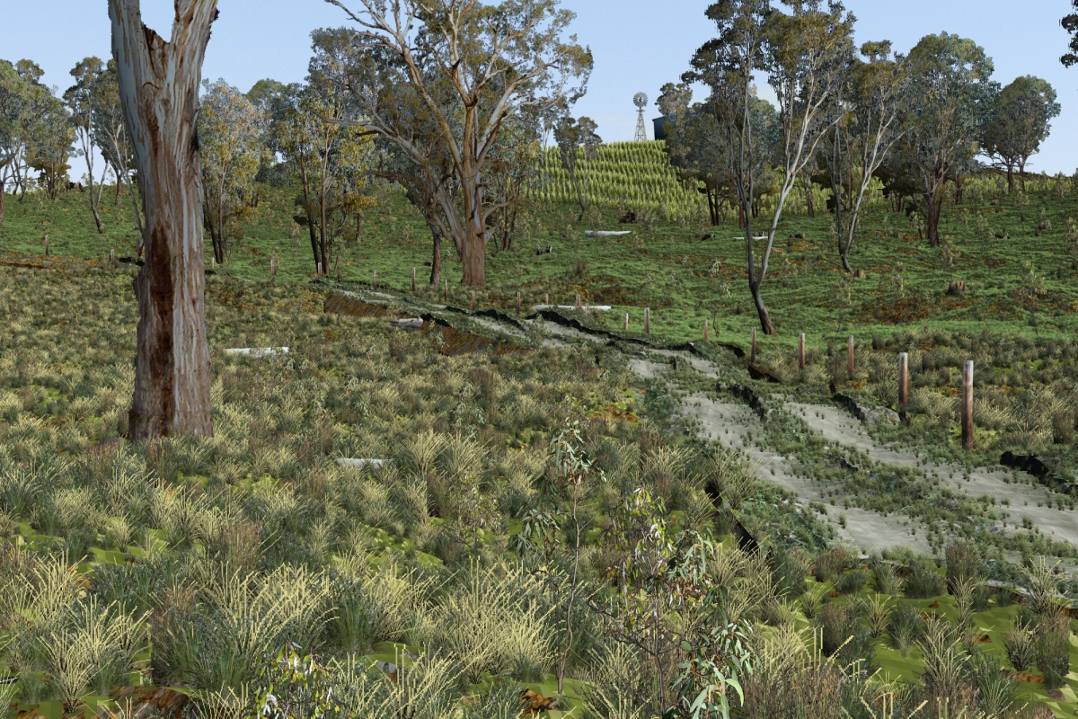
Medium condition site – benchmark attributes measured
reduced cover of trees
reduced recruitment
reduced understorey diversity
increased cover of weeds
Habitat score = 5/10

Slide 16
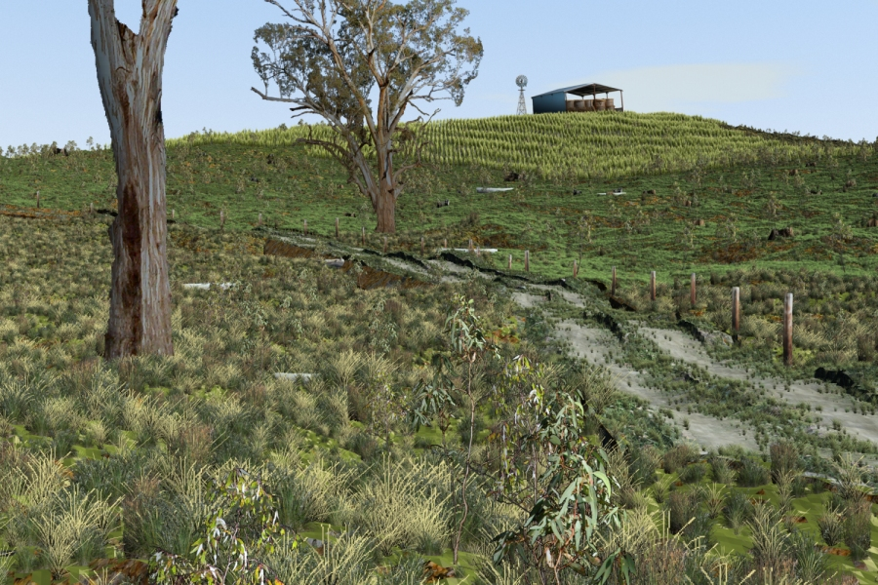
Low condition site – benchmark attributes measured
greatly reduced vegetation in landscape
only relict trees
increased cover of weeds
greatly reduced understorey diversity
Habitat score = 2/10

Slide 17
Measuring quality - Habitat score
Assessed against
a benchmark for
each habitat type
Notes:
17
The method is based on seven site attributes and three landscape attributes.
The attributes are assessed against a benchmark for each vegetation type.
The biodiversity metric is the product of the site area ( in hectares) and the habitat score – it is called Habitat Hectares.
The Habitat hectare metric is used to measure biodiversity losses and gains.

Slide 18
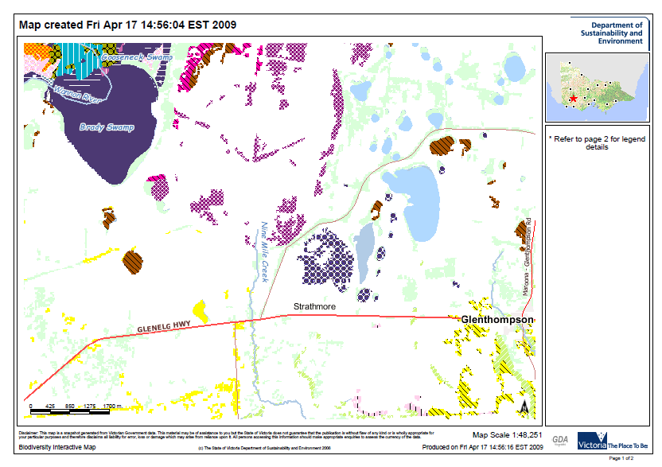
Biodiversity information
Current extent of vegetation
Type (Ecological Vegetation Classes)
Benchmarks
1750 vegetation mapping
Bioregions – 28
Threatened species records

Slide 19
Biodiversity Significance
  Levels of biodiversity significance based on:
    Rarity of the vegetation type
    Quality of the vegetation
    Occurrence of threatened species
    Other attributes – Ramsar wetlands, National Estate …
    four levels of Significance
  Offset criteria are graduated according to biodiversity significance
      eg like for like
Notes:
Levels of Conservation Significance based on:
Rarity of the vegetation type
Quality of the vegetation
Occurrence of threatened species
Other attributes – Ramsar wetlands, National Estate …
there are four levels of Significance – Very High, High, Medium, Low
Offset criteria are graduated according to Conservation Significance
eg like for like

Slide 20
Offset criteria - Like for like
Biodiversity significance | Very High | High | Medium | Low
Vegetation or habitat type of offset | The same vegetation/ habitat type in same bioregion | Same vegetation/habitat type OR a VERY HIGH type in same bioregion | Any type in the Bioregion OR a VERY HIGH or HIGH in same or adjacent Bioregion | Any type in the Bioregion OR a VERY HIGH or HIGH in same or adjacent Bioregion
⬅ Graduated response
⬅ Trading Up
Notes:
This table is from the Framework. It shows the like for like rules for an offset according to the four levels of Conservation Significance.
For Very High, the offset must be of the same vegetation or habitat type in the same bioregion.
At the other end for Medium and Low, the offset can be any vegetation type in the same Bioregion.
An important feature of these rules is the ‘trading up’ facility. So, for example, an offset for a High impact can be either the same type in the same bioregion OR any Very High type in the Bioregion.
Trading up provides significant flexibility to the supply side of the offset market.

Slide 21
Loss and Gain
For No Net Loss:
Loss at the development site = Gain at the offset site
  where
Loss at the development site
= area x quality score (habitat hectares)
  and
Gain at the offset site
  = area x quality score increment/ha
Notes:
For No Net Loss;
The loss measured at the development site must equal the gain measured at the offset site
The loss at the development site:
Loss = area x habitat score (habitat hectares)
And the Gain at the offset site:
Total gain = area x habitat score increment/ha
Increments in the attributes of the Habitat Score are related to actions that improve the management or security of the site.

Slide 22
Types of Gain
Three types of gain:
  Security gain – where the offset is located:
    On private land with an on-title management agreement
    On public land with greater security (protected area)
    Surrender private land to public protected area
  Maintenance gain
    Forego entitled uses
    Control weeds
  Improvement gain
    Supplementary planting
    Reduce weed cover
Notes:
There are three types of gain:
Security gain – where the offset is located:
On private land with an on-title agreement
On public land with greater security (protected area)
Through the surrender private land to public protected area
Maintenance gain
Forego entitled uses such as grazing and taking of timber
Control weeds
Improvement gain
Supplementary planting of indigenous species
The reduction of weed cover

Slide 23
Estimating Gain
Total gain = area x quality increment per hectare
Improvement gain
  Increments in quality attribute scores resulting from actions in the management plan
Maintenance gain
  Increments in quality attribute scores resulting from actions in the management plan
Security gain
  Increments in overall quality score depending on the change in land category

Slide 24
Example - Security Gain calculation
Long-term chance of loss through clearing %
0
10
30
40
50
100
Class 1
Protected area
Private land
under covenant
Class 2
Protected area
Private land
Security gain = current habitat score x increase in security (in ‘Habitat hectares’)

Slide 25
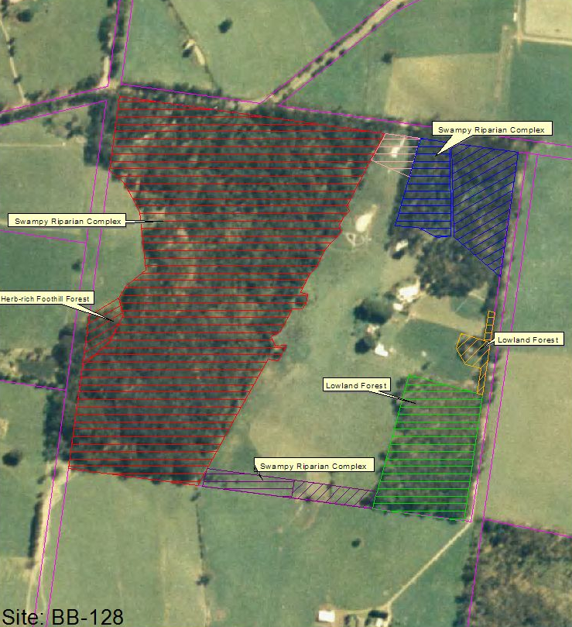
Assessing loss and gain on site
Site assessment:
  Site definition, habitat zones
  Habitat type
  Quality score
  Threatened species
  Biodiversity significance
  Loss score; or
  Management plan & gain score
  by accredited officer
Relies on state-wide information!

Slide 26
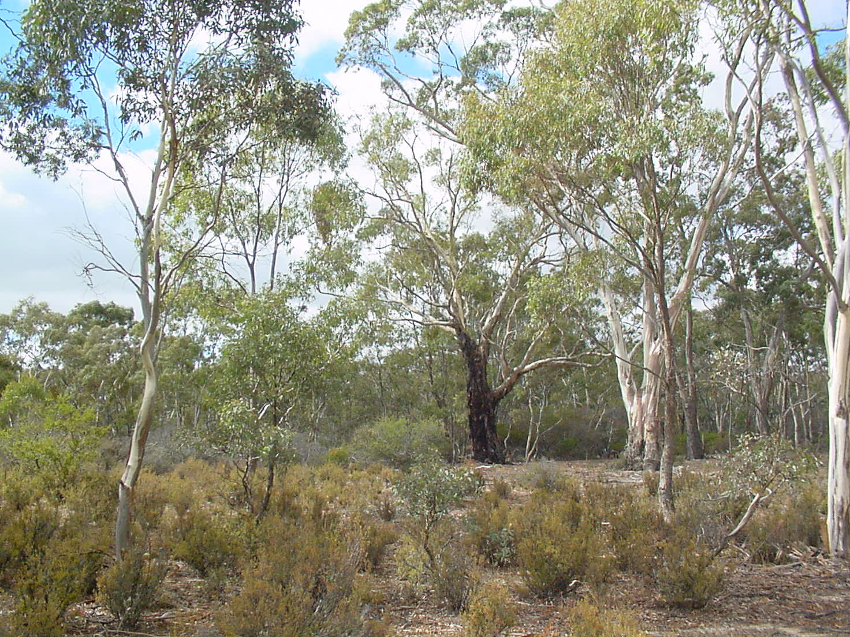
Landowner agreement - Typical landholder actions
Retain trees
Control rabbits
Exclude grazing
Control weeds
Notes:
Successful bidders sign a management agreement which contains:
their site management plan which describes the action they will undertake over the life of the agreement. Typical actions include weed control, rabbit control, fence building to exclude stock and the retention of trees and fallen timber
provisions for reporting and monitoring of progress by the landholder and the annual payments by the Department
other contractual provisions relating to matters such as sale of land, termination and access to the site.
In the trials, fixed-term (three and six years) and permanent (covenants) management agreements were offered.

Slide 27
Specification of the offset
Developers
Developers required to provide offsets, either by:
  first party; or
  third party
Loss site assessment,
Permit application
Local Government
Determine small impacts
Refer large impacts
to
State Government
Permit may be granted
Permit includes offset conditions – offset plan

Slide 28


Third party supply of offsets through a market
Developers = “BUYERS”
Credit Register
Record of ownership
Provides transparency & accountability to the market
Provides market confidence that the credits meet the standards
Single place where information about credits is recorded
Ensures credits are only ‘used’ once
Brokers
Conservation Banks
Over the counter
Create credits:
Landowner agreements
Land surrender
Upgrade protected areas
Government
“SELLERS”
=
Landowners
=
Notes:
This is an illustration of how the offset system can work. It is adapted from the system in place in Victoria, Australia.
Essentially, developers need to demonstrate No Net Loss to get permission to go ahead with their projects.
The developer’s impacts are assessed by government. Small impacts are assessed by local authorities (using simple metrics), while more significant impacts are assessed by national agencies, using the metrics and methodologies set out in the national law and regulations. This process defines the offset that the developer needs.
The developer faces a number of choices as to how to fulfill its offset obligations. It can implement the offset itself (subject to the same standards as others face) if it would like. Alternatively, it can obtain its offset from ‘third parties’, namely landowners prepared to generate conservation credits on their land or from specialist conservation banks.
‘Sellers’ can therefore include farmers, Parks/Protected Areas (including private and community PAs), communities, local authorities, NGOs, conservation banking companies
The developer can find third party offsets by consulting a broker.
Once the offset is defined and its implementation is established according to national standards, it is entered in the National Biodiversity Credit Register. We’ll discuss registers later, but essentially the register is needed to prove the offset meets national standards and to make sure the offset isn’t sold twice to different companies.

Slide 29

Development of system over time: Victoria
1989 - Regulation of native vegetation clearing
  an end to broad-scale clearing
However offsetting was sporadic and unquantified
1998 - Biodiversity mapping
  extant vegetation, 1750 vegetation, bioregions, threatened species
Provided state-wide information base
2000 - Auction-based incentive program – BushTender
  introduced site assessment, landowner agreements
Development of key techniques outside regulatory environment
2002 - Native Vegetation Management Framework
  no net loss, like-for-like, metrics
However developers found it hard to find their offsets
2007/8 - Offset market based on credit trading
  third party suppliers, brokers, credit register
Led to much better supply of offsets, but system too confused and too complex, problems on measurement
2013 - Reform of Native Vegetation permitted clearing regs
  clarified objectives, improved measurement of biodiversity, incorporated risk and proportionality, ensures appropriate compensation
Think there’s something 2016 to add

Slide 30
Market mechanism -Brokers
Brokers
  find buyers and sellers for bespoke deals
  match using like-for-like rules
  facilitate price negotiation
BushBroker
  the government-operated broker (2007)
  government start-up funding, now in cost recovery
  >300 trades, $34 million in value
Private brokers
  Training and accreditation
  eg ESLink (2010), ~ 30 trades by 2018….continuing

Slide 31
Offset market - credits
Credits represent:
  A gain in the extent and or quality of native vegetation
Credits are:
  The unit of trade in the offset market
  Measured in habitat hectares
  Also measured in Large Old Trees, number of plants
  Divisible
  Listed on the government operated Credit Register

Slide 32
Credit creation
The landowner agreement:
  permanent statutory contract
  binds future landowners – on title
  management actions specified in detail
  agency access to site
  reporting and monitoring
  progress payments
Land surrender:
  private land donated to a Protected Area
Upgrade Protected Area:
  government re-classify public land to higher security

Slide 33
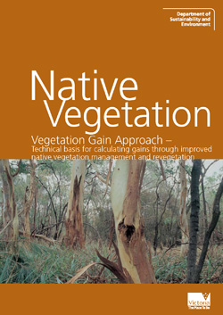
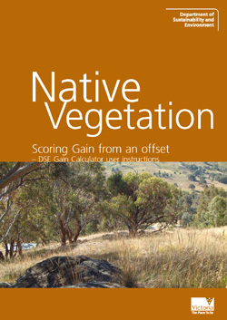
Offset market - Standards for credits
Quality Assurance – Standards, training, accreditation:
Site assessment - Vegetation Quality Assessment Manual
Assessment by accredited field officers
Gain calculated according to the Vegetation Gain Approach
Site management and revegetation standards

Slide 34

Offset market - credit register
Purpose of the Credit Register:
Record of ownership of credits
Provides transparency and accountability to the credit market
Provides the market with confidence that the credits meet the standards
A single place where information about credits is recorded
Ensures credits are only ‘used’ once
BushBroker
Credit Register
Other brokers

Slide 35
Offset market - credit prices
Bioregion | Number of Agreements | Total number of Habitat Hectares | Average price per Habitat Hectare * (of total Agreements) | Habitat Hectare price range * (more than 80% of Agreements)
Central Victorian Uplands | 8 | 10 | $110,000 | $46,000 - $143,000
Gippsland Plain | 21 | 29 | $149,000 | $85,000 - $250,000
Goldfields | 39 | 38 | $45,000 | $25,000 - $66,000
Victorian Riverina | 10 | 11 | $101,000 | $80,000 - $110,000
Victorian Volcanic Plain | 29 | 54 | $170,000 | $49,000 - $267,000
Highlands-Southern Fall | 14 | 74 | $34,000 | $20,000 - $38,000
Other bioregions | 11 | 25 | $370,000 | $206,000 - $380,000
Prices vary by bioregion, EVC, location, rarity, demand and urgency of developer, landowner needs. Also initial trade, small or large trades

Slide 36
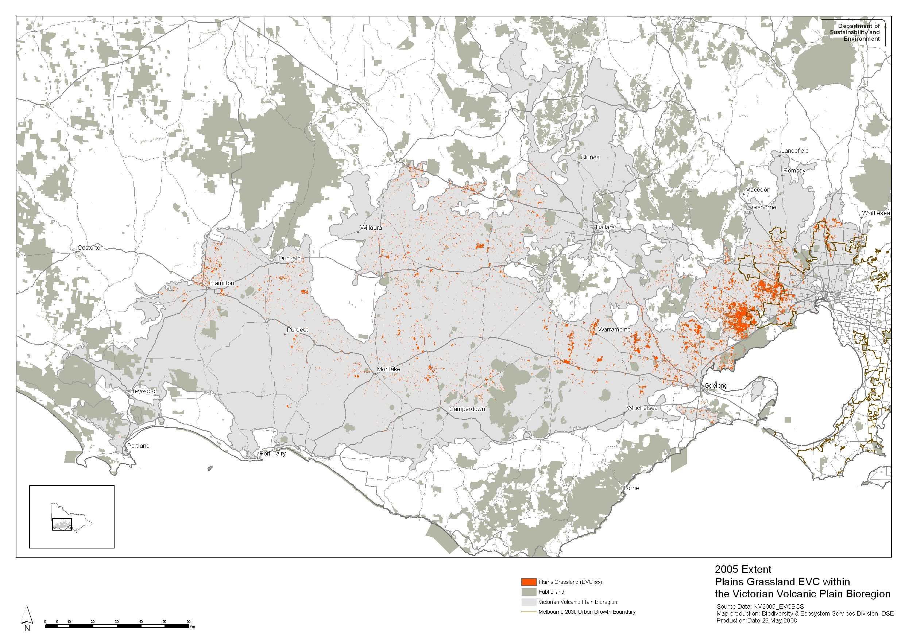
Market mechanism – aggregated offset example
Plains Grassland -
Victorian Volcanic Plain
Notes:
The Victorian government announced its intention to establish a 15,000 hectare grassland reserve west of Melbourne
last remaining large contiguous areas in the bioregion – see map
the reserve will provide offsets for Melbourne’s future urban development
The sale of credits will progressively finance the acquisition of 140 properties in the reserve area

Slide 37
Offset market mechanisms
Risk to supplier increases
Credit types
Demand high and certain
Demand low and uncertain
Aggregated offsets & banks
Bespoke trades through brokers
Like-for-like rules (including trading up) determine market segmentation:
  Low segmentation → banks and landscape solutions
  High segmentation → bespoke and individual site solutions
Notes:
the like for like rules determine the number of credit types that are non-exchangeable
demand for different credit types will vary, depending upon where development is occurring
where demand is relatively high and certain, banks will be viable and investors will emerge
aggregated offsets are the least risky as supply and demand are organised at the same time
where demand is relatively low and uncertain, banks are unlikely and bespoke or tailor-made offsets need to be arranged
homogenous like for like rules may lead to ‘efficient’ markets, but they take the diversity out of biodiversity
need to strike a balance
consideration of risk is one of the important factors to consider in the design of an offset market

Slide 38
Aggregated offset - Western Grassland Reserve
A 15,000 ha reserve through the purchase and surrender of freehold land
Will provide offsets for 15 years of urban development in Melbourne’s west
Designed via a Strategic Assessment Report of future impacts and offsets
Land designated under an acquisition overlay
Financed through a revolving fund, primed with government funding
Notes:
The Victorian government announced intention to establish a 15,000 hectare grassland reserve west of Melbourne
last remaining large contiguous areas in the bioregion
the reserve will provide offsets for Melbourne’s future urban development
The sale of credits will progressively finance the acquisition of 140 properties in the reserve area
planning decisions on the demand and supply side made at the same time , so basically an aggregated offset

Slide 39
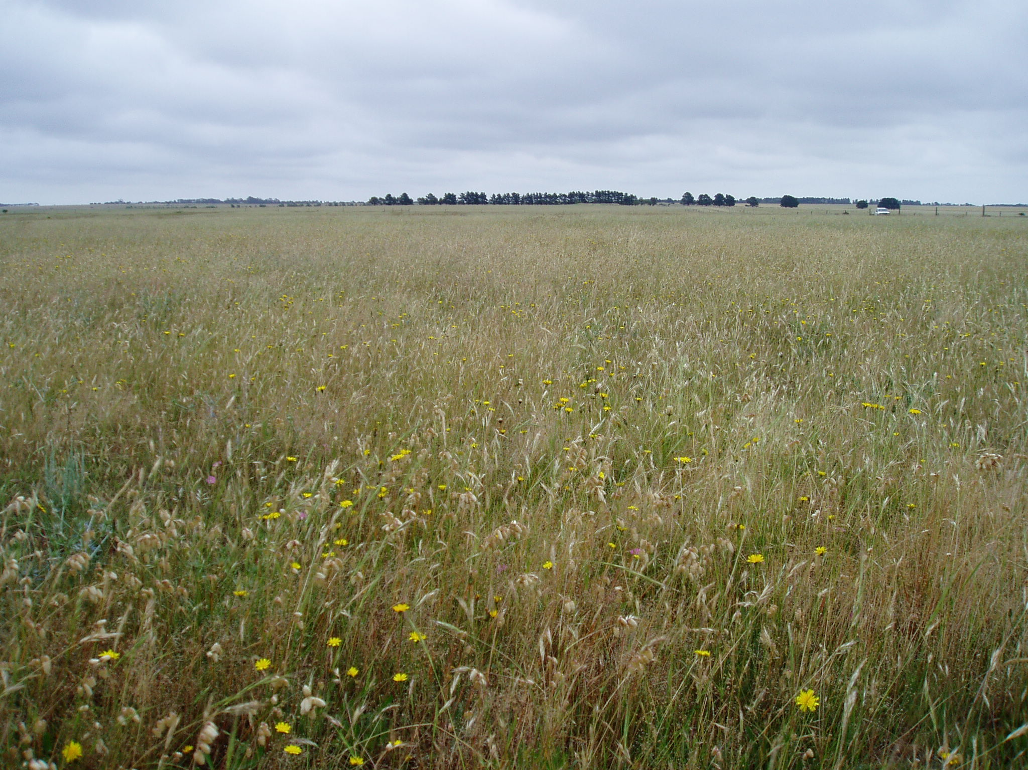
Western Grassland, near Melbourne
Notes:
Areas of native grasslands are found in the north and west

Slide 40
Market mechanism – Over The Counter
Over The Counter:
  a bank of credits available at price pre-set by the landowner
  based on ‘trading up’ to higher conservation significance
  offset specified in the permit condition
  offset plan provided at time of purchase
  walk in and buy - feels like ‘in lieu payment’
Notes:
some scattered trees clearing can be offset by revegetation – number of plants metric
a landowner has signed an agreement for revegetation involving 20,000 plants (second contract, first was 6000 plants)
landowner bears risk of demand
these offsets are provided ‘over the counter’ at DSE office
landowner sets fixed price for plants
very successful - 34 offsets in this bank to date
plant credits are not tradeable
Planning to seek tenders for landowners to set up HHa banks in some localities
private company has established habitat hectare bank through land surrender into a national park
15 offsets to date
they are currently surrendering additional land
2. Villawood land surrender – sale of habitat hectares via contract
45 HHa bank created through land surrender to a National Park
15 separate offsets provided to date
Company currently establishing further banks

Slide 41
Concluding thoughts from Michael Crowe
Michael Crowe prepared these slides based on his experience establishing and administering this system in Victoria. He recommends:
  Start simple and then build improvements over time
  Develop and test concepts in other areas e.g. use metrics in incentives program first
  Involve scientists in development of new information techniques
  Scale rigour and cost of offset transactions to significance and size of impacts
  Focus the purpose of offsetting on compensating for biodiversity losses
  Compliance for credit suppliers – progress payments
  Offsetting needs to be regulated

